Slide 1
I'm mechanical engineer from Hungary, but working in India in quality leader position.
As a passion, I started to work on a robot rover shield for Arduino MEGA.
One of the main goals is to come up with a generic, but versatile shield, which can be interesting for others as well.
The following features are already included:
- 2 DC motor control 2x (pwm + dir1/dir2) for external motor driver.
- 2 encoder input (magnetic type)
- battery volt & capacity measurement ;)
- rain sensor
- I2C: 4x20 LCD display
- I2C: 9 DOF IMU (Bosch BNO055)
- 3 ultrasonic distance sensor(left, right & ceter)
- 3+ momentary buttons
- PS2 controller for manual mode
- XBee, GSM, GPS on serial port 1-3
- Jetson Nano on serial 0 (for visual servoing with simple webcam)
More can be added:
- head light control
- 3? servo motor control
- ...
I made the draft schematics & PCB in KiCad.
Draft scripts in C++ and in Python for Jetson Nano are available
and a 1m x 1m x 0.5m rover as well to test, how all works together. ;)
As of now, I'm the only one in the project and about to finalize the schematic & PCB.
If Your are in, kindly let me know.
Thank You for your help and support in advance.
Warm Regards,
Andras
andras.steger@protonmail.com

Slide 2
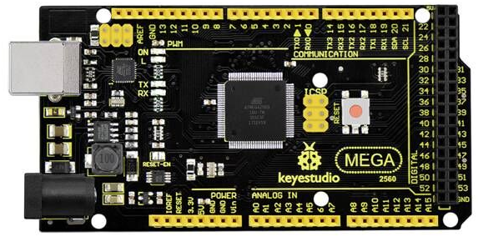
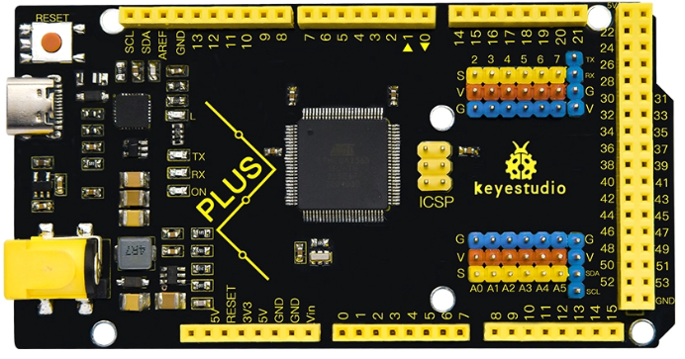
https://wiki.keyestudio.com/Ks0342_Keyestudio_MEGA_2560_Compatible_Board_Advanced
Keyestudio MEGA 2560 Compatible Board Advanced
Analog pins
Digital/pwm pins
Serial pins
Digital pins
I2C
Battery voltage
Motor controller LEFT side
GPS
PS2 controller (3V3)
4x20 LCD panel
Battery current
GSM
Rain drop sensor
IMU
Motor controller RIGHT side
Digital pins
Jetson Nano
Ambient temp.
Battery temperature
XBee
3 ultrasonic distance sensors
AMS1117 – 1A
NSP1117 – 1A
5 buttons
MP2307DN - 2A or 3A ?
MP2308DN - 4A

Slide 3
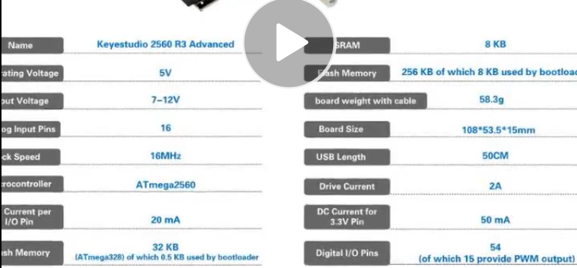

Slide 4
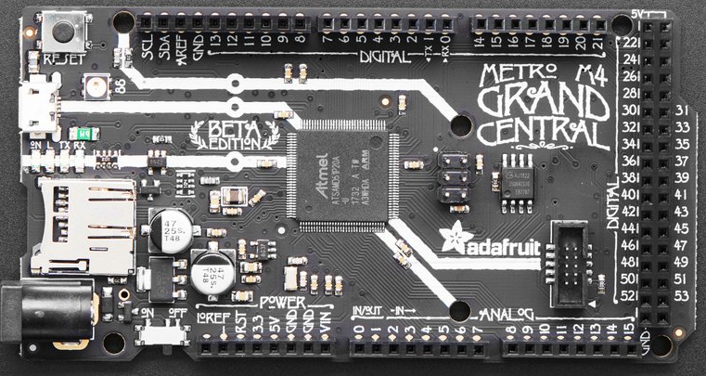
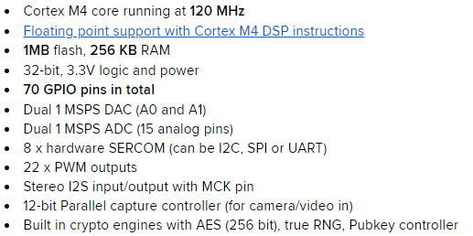
Adafruit Grand Central M4 Express featuring the SAMD51
https://www.adafruit.com/product/4064

Slide 5
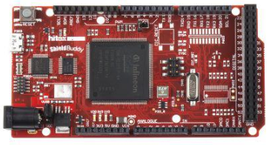
WEEDINATOR/docs/TC275.pdf
@ SembazuruCDE: Thank You for the suggestion, I was not aware with this board.
Actually this is the second part, which is to be revised: overall control MCU.
If I put more time-consuming stuff then the speed go slow.
Checking the sensors and control the motor + GPS + XBee.
I attached the planned components. (red is where the 3V3 is not possible.)
I was thinking on these MCUs:
Ks0342 Keyestudio MEGA 2560
https://wiki.keyestudio.com/Ks0342_Keyestudio_MEGA_2560_Compatible_Board_Advanced
(5V 2A regulator onboard and improved 3.3V regulator, that can run from a +12V supply.)
Hitex ShieldBuddyTC275 – AURIX™
https://www.infineon.com/cms/en/product/evaluation-boards/kit_aurix_tc275_ard_sb/
(Infineon TC275 32-bit 3 core processor, but very expensive)
Or just use 2 MEGA with same Shield (different components are soldered according to the role.)

Slide 6
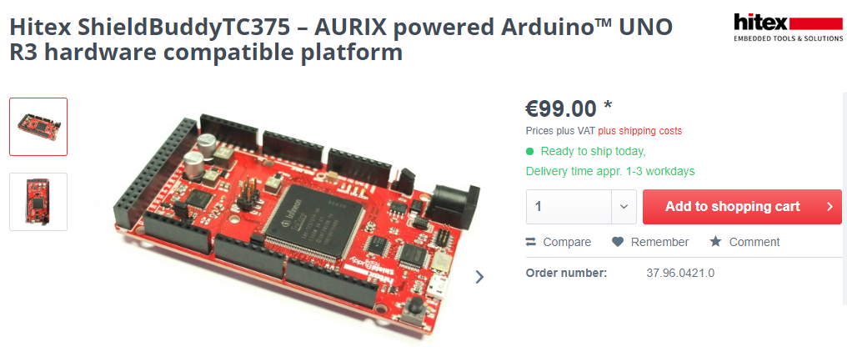
https://www.ehitex.de/en/starter-kits/for-aurix/2693/hitex-shieldbuddytc375-aurix-powered-arduino-uno-r3-hardware-compatible-platform

Slide 7
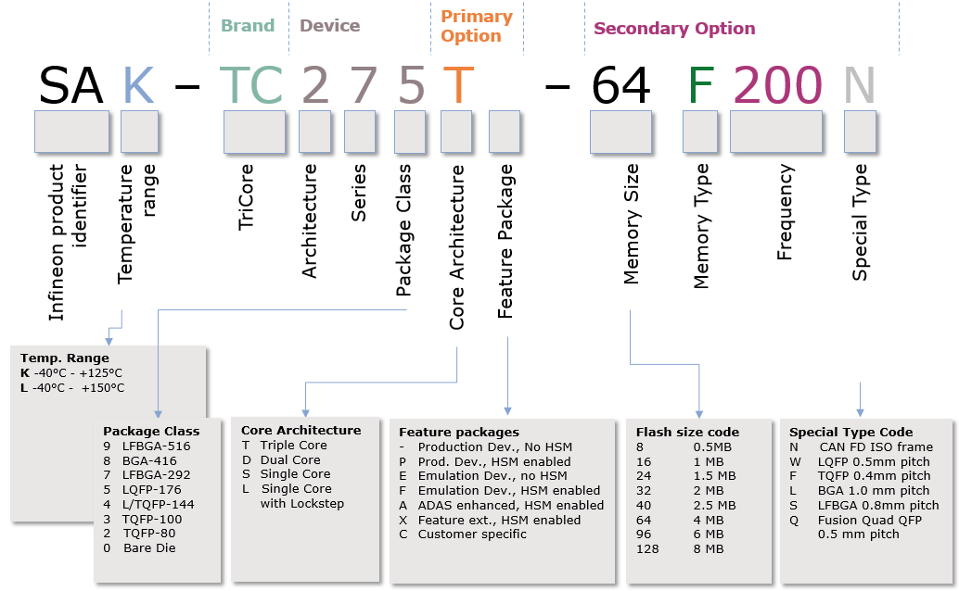
https://free-entry-toolchain.hightec-rt.com/

Slide 8
 | MEGA | Due | Keyestudio MEGA 2560 Advanced | Grand Central M4 Express | Hitex ShieldBuddy TC275 | ESP32 | Teensy 4.1
CPU | ATMEGA2560-16AU | Atmel SAM3X8E ARM Cortex-M3 | ATMEGA2560-16AU | Cortex M4 SAMD51 | AURIX TC275 | Xtensa | Cortex-M7
CPU speed | 16 MHz | 84 MHz | 16 MHz | 120 MHz | 200 MHz (each core sep.) | 160 or 240 MHz | 600 MHz
Bit | 8 | 32 | 8 | 32 | 32 | 32 | 32
Core | 1 | 1 | 1 | 1 | 3 | 1/2 | 1
Prog. Flash | 256 kB | 512 kB | 256 kB | 1 MB | 4 MB | 520 kB | 8 MB
RAM/Data Flash | 8 kB | 96 kB | 8 kB | 256 kB | 384 kB |  | 1 MB
QSPI Flash |  |  |  | 8 MB
Logic level | 5 V | 3.3V | 5V | 3.3V | 5V |  | 3.3V
DC Current per I/O Pin | 20 mA | 130 mA (all I/O lines) | 20 mA |  |  |  | 4mA
DC Curr. for 3.3V Pin | 50 mA | 50 mA | 50 mA
DC Curr. out on 5V Pin | 0.8 A | 0.8 A | 2A
Dig. pins | 54 | 54 (12 PWM) | 54 (15 PWM) | 70 (22 PWM) | 64 | 16 PWM+motor | 40 (35 PWM)
Analog pins | 16 | 12 (ADC 12 bit) | 16 | 15 | 48+12 |  | 18
UART | ✓ 4 | ✓4 | ✓4 | ✓ | ✓ | ✓3 | ✓8
I2C | ✓ | ✓ | ✓ | ✓ | ✓ | ✓2 + (I2S) 2 | ✓3
CAN | ✗ | ✗ | ✗ | ✗ | ✓ 4 nodes | ✓ | ✓3
SPI | ✓ | ✓ | ✓ | ✓ | ✓ | ✓4 | ✓3
Ext. interrupt | 2, 3, 18, 19, 20, 21 | All digital pins |  | ✓
Extra |  |  |  | Micro SD card CircuitPython |  | WiFi, BT | Micro SD card Ethernet, mem exp.

Slide 9
 | MEGA | Due | Keyestudio MEGA 2560 Advanced | Grand Central M4 Express | Hitex ShieldBuddy TC275 | Hitex ShieldBuddy TC375 | KIT_A2G_TC375_LITE
CPU | ATMEGA2560-16AU | Atmel SAM3X8E ARM Cortex-M3 | ATMEGA2560-16AU | Cortex M4 SAMD51 | AURIX TC275 | AURIX TC375
CPU speed | 16 MHz | 84 MHz | 16 MHz | 120 MHz | 200 MHz (each core sep.) | 300 MHz
Bit | 8 | 32 | 8 | 32 | 32 | 32
Core | 1 | 1 | 1 | 1 | 3 | 3
Prog. Flash | 256 kB | 512 kB | 256 kB | 1 MB | 4 MB | Up 6 MB flash
RAM/Data Flash | 8 kB | 96 kB | 8 kB | 256 kB | 384 kB | Up to 1.1 MB SRAM
QSPI Flash |  |  |  | 8 MB
Logic level | 5 V | 3.3V | 5V | 3.3V | 5V
DC Current per I/O Pin | 20 mA | 130 mA (all I/O lines) | 20 mA
DC Curr. for 3.3V Pin | 50 mA | 50 mA | 50 mA
DC Curr. out on 5V Pin | 0.8 A | 0.8 A | 2A
Dig. pins | 54 | 54 (12 PWM) | 54 (15 PWM) | 70 (22 PWM) | 64 | 128x DMA channels
Analog pins | 16 | 12 (ADC 12 bit) | 16 | 15 | 48+12 | Up to 104x ADC channels
UART | ✓ 4 | ✓4 | ✓4 | ✓ | ✓
I2C | ✓ | ✓ | ✓ | ✓ | ✓
CAN | ✗ | ✗ | ✗ | ✗ | ✓ 4 nodes | 8xCAN FD
SPI | ✓ | ✓ | ✓ | ✓ | ✓
Ext. interrupt | 2, 3, 18, 19, 20, 21 | All digital pins |  | ✓
Extra |  |  |  | Micro SD card CircuitPython

Slide 10
https://www.infineon.com/cms/en/product/microcontroller/32-bit-tricore-microcontroller/32-bit-tricore-aurix-tc3xx/aurix-family-tc37xtp/

Slide 11
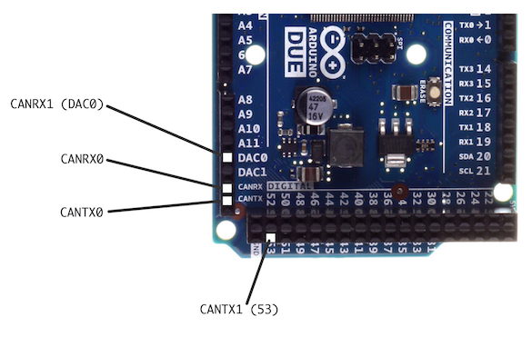
– Application Kit TC397 V2.0 with VEXT=5V
– Application Kit TC397 V2.0 with VEXT=3,3V
– Application Kit TC387 V2.0 with VEXT=5V
– Application Kit TC387 V2.0 with VEXT=3,3V
Welcome to the ShieldBuddy forum!
https://aurduino.boards.net/
https://copperhilltech.com/blog/arduino-due-can-bus-controller-area-network-interfaces/

Slide 12
Information flow
Compass
Motor drive
Motor remote control (PS2)
GNSS/GPS
GSM/GPRS/SMS
Bat. Volt & current measure.
MCU 1
(can be slow)
MCU 2
(must be fast)
Serial com.
LCD display
Rain & amb. temperature sensor
Heading
Bearing
Coordinates
Distance from waypoint
Ultrasonic distance sensor
Push buttons for status
Audio ?
GSM/GPRS/SMS
Serial com.
Camera
Advanced object recognition
Jetson Nano
(must be fast)

Slide 13
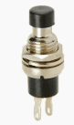
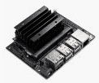
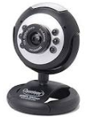
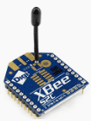
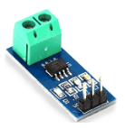
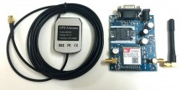
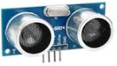
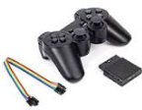
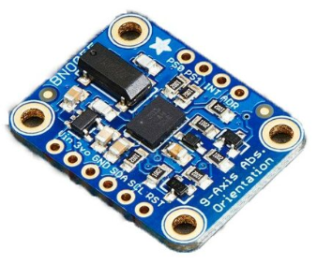
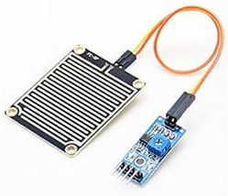
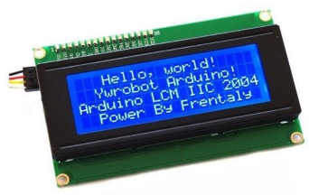
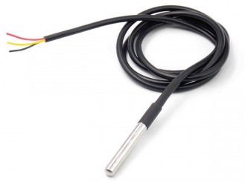
https://forum.arduino.cc/index.php?topic=723271.0
Momentary push buttons (x3) with proper resistors
Robot Rover Shield on MEGA
Jetson Nano 4GB B01
Simple webcam
A2 or D49,D51,D53
RX0/TX0
Divided voltage from Vcc=12V for battery terminal volt measurement
A0
RX3/TX3
XBee 2mW or 63mW 3V3
A1
ACS712 30A; 3.3-5V
or INA 213
SIM808 GSM/GPRS/GPS Module with GPS and GSM Antenna
RX1/TX1
5V as well as
3.3V logic levels
PWM Left / Right
D2/D3
Encoder Left / Right
D4/D5
Trig/EchoL D31/33
Trig/EchoR D35/37
Trig/EchoC D39/41
Enable Left1/Left2
D32/D36
HC-SR04
5V/15mA
(Volt divider 4.7kΩ & 2.7kΩ
required on Echo pin)
Enable Right1/Right2
D40/D44
PS2 wireless remote 2.4GHz; 3V3
D23,D25,D27,D29
SCL
SDA
BNO055 9-DOF (0x28)
3V3 or 5V
Rain drop sensor
A&D output; 3V3 - 5V
D52/A14
D5
LCD2004 LCD with I2C
(0x27) 5V/40mA
(negative voltage generator
to be soldered on the back)
DS18B20 Temperature Sensor 3.0 – 5.5V

Slide 14
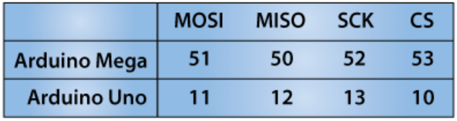
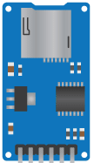
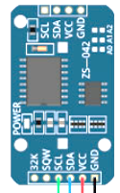
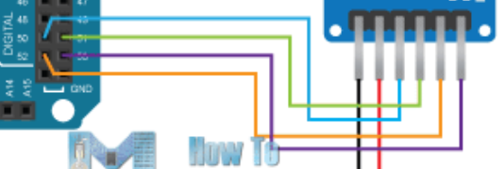
https://www.youtube.com/watch?v=5Dp-XatLySM
https://howtomechatronics.com/tutorials/arduino/arduino-sd-card-data-logging-excel-tutorial/
https://howtomechatronics.com/tutorials/arduino/arduino-ds3231-real-time-clock-tutorial/
50, 51, 52, 53
DS3231 Real Time Clock
With temp. sens
0x57
SPI SD card

Slide 15
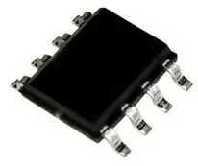
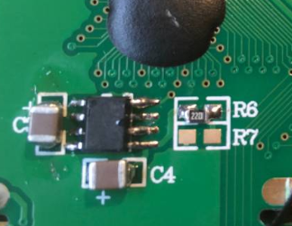
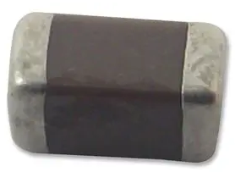
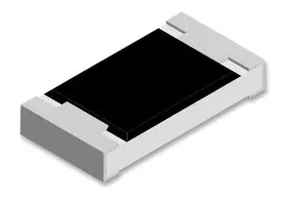
https://www.element14.com/community/groups/roadtest/blog/2019/06/15/converting-5v-lcds-to-33v
https://www.element14.com/community/view-product.jspa?fsku=9663703&nsku=61J6203&COM=noscript
https://in.element14.com/multicomp/mc1206f106z100ct/cap-10-f-10v-y5v-1206/dp/1759434?COM=referral-cmty-noscript
https://in.element14.com/multicomp/mcwr04x2201ftl/res-2k2-1-0-0625w-thick-film/dp/2447148?st=2k2
How to convert 5V 4x20 LCD to 3V3:
ICL7660
ICL7660CBAZ
10 µF, 10 V, 1206 [3216 Metric], +80%, -20%, Y5V, MC Serie
MCWR04X2201FTL
MC1206F106Z100CT
2.2k Ohm resistor across pad R6
two 10µF capacitors across pads marked C3 and C4

Slide 16
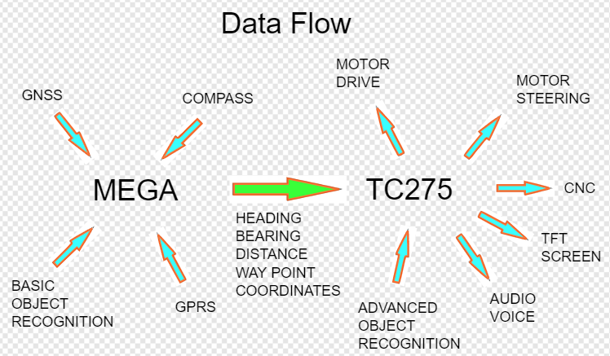

Slide 17
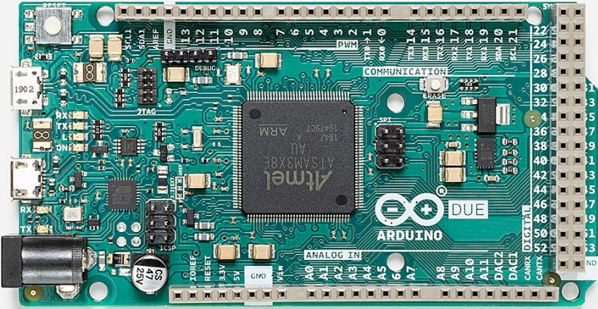
+3.3V
Buck regulator or LM7833
12V
LiFePO4

Slide 18
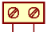
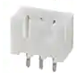
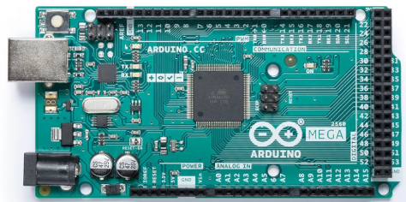
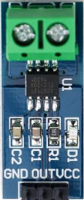
1 A
* PS2 controller ** 3xUltras. Distance *** Motor Direction **** 3xPush buttons
***** PWM, encoder etc.
To buck converter
From buck converter
For external reference
JST-XH 2.5mm
With 2,3,4,7 pins
78033V3
!
R1
1N4001
15 A
4xSerial
3xI2C
To 2 x motor controller power
*****
15 A
*
!
R2
**
12V
LiFePO4
***
For battery volt meter
R3
100n
(ceramic)
****
ACS712

Slide 19
From buck converter
* PS2 controller ** 3xUltras. Distance *** Motor Direction **** 3xPush buttons
***** PWM, encoder etc.
To buck converter
For external reference
1 A
JST-XH 2.5mm
With 2,3,4,7 pins
78033V3
A
R1
1N4001
15 A
4xSerial
3xI2C
B
To 2 x motor controller power
*****
15 A
*
R2
**
12V
LiFePO4
***
For battery volt meter
R3
100n
(ceramic)
!
****
ACS712

Slide 20
From buck converter
* PS2 controller ** 3xUltras. Distance *** Motor Direction **** 3xPush buttons
***** PWM, encoder etc.
To buck converter
For external reference
1 A
JST-XH 2.5mm
With 2,3,4,7 pins
78333V3
R1
1N4001
15 A
4xSerial
3xI2C
To 2 x motor controller power
*****
15 A
*
R2
**
12V
LiFePO4
***
For battery volt meter
R3
100n
(ceramic)
****
ACS712

Slide 21
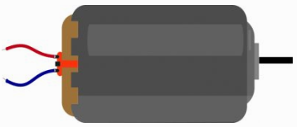
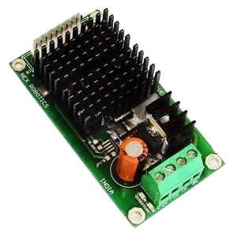
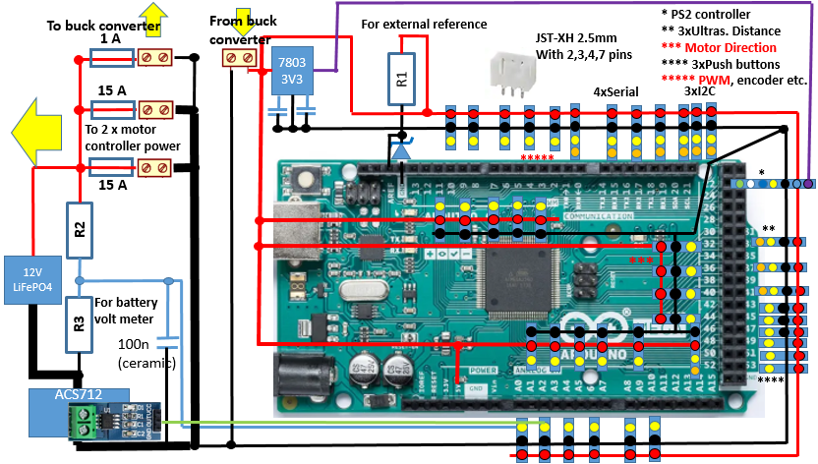
The motors, the Shield & MEGA are powered by the same, 12V battery. The motor controllers are physically already separated (20cm).
I just moved the power line for the motors on the PCB to easily connect the parts (volt & current meter, fuses & screw terminal).
If I make the orange, dashed rectangle on a separated PCB (connection remain the same.) will it help ?
Motor controllers
PWMA
DIR1A
DIR2A
PWMB
DIR1B
DIR2B
Junction terminal
!

Slide 22
Top & Bottom cupper layers with max. pour, connected with array of vias
2xMotor controller (2x15A)
1mm trace
1mm trace
Distance: 5 cm (2”)
Junction terminal/box
3mm trace
2x15A fuses
10µ & 0.1µ
12 V LiFePO4
Battery
12V
12V
5V
Shield with MEGA
Buck regulator
5V
R2
ACS712
For battery amp meter
A1
100µF- 470µF
R3
10µ & 0.1µ
Distance: 5 cm (2”)
A0
3mm trace
For battery volt meter

Slide 23
2xMotor controller (2x15A)
Distance: 5 cm (2”)
Junction terminal/box
2x15A fuses
12 V LiFePO4
Battery
12V
12V
5V
Shield with MEGA
Buck regulator
5V
R2
ACS712
For battery amp meter
A1
R3
Distance: 5 cm (2”)
A0
For battery volt meter

Slide 24
2xMotor controller (2x15A)
Junction terminal
Distance: 5 cm (2”)
2x15A fuses
10µ & 0.1µ ǁ
12 V LiFePO4
Battery
12V
1 A
12V
5V
Shield with MEGA
Buck regulator
5 V
R2
ACS712
For battery ampere meter
A1
100µF- 470µF
R3
Distance: 5 cm (2”)
10µ & 0.1µ ǁ
A0
For battery volt meter

Slide 25
Top & Bottom cupper layers with max. pour, connected with array of vias
2xMotor controller (2x15A)
1mm trace
1mm trace
Distance: 5 cm (2”)
Junction terminal/box
3mm trace
2x15A fuses
10µ & 0.1µ
12 V LiFePO4
Battery
12V
12V
5V
Shield
Buck regulator
5Vin
GND
MCU
R2
ACS712
For battery amp meter
A1
100µF- 470µF
R3
10µ & 0.1µ
Distance: 5 cm (2”)
A0
3mm trace
For battery volt meter

Slide 26
2xMotor controller (2x15A)
Distance: 5 cm (2”)
PCB - Junction terminal
2x15A fuses
12 V LiFePO4
Battery
12V
12V
5V
PCB - Shield
Buck regulator
5Vin
GND
MCU
R2
signal GND
ACS712
For battery amp meter
A1
R3
Distance: 5 cm (2”)
A0
Motor GND
For battery volt meter

Slide 27
Buck regulator
2xMotor controller (2x15A)
Distance: 5 cm (2”)
12V
12V
PCB - Junction terminal
2x15A fuses
5V
12 V LiFePO4
Battery
12V
PCB - Shield
5Vin
GND
MCU
R2
ACS712
signal GND
For battery amp meter
A1
R3
100µF- 470µF
Distance: 5 cm (2”)
0.1µ
MCU GND
A0
For battery volt meter

Slide 28
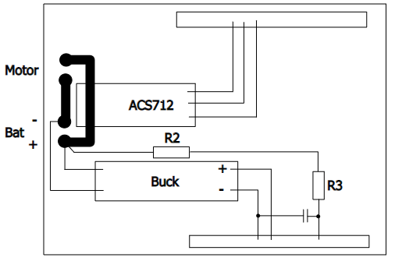
assuming all the parts (including the buck and the acs) should be mounted on a shield for an arduino or a raspi. I don’t know the pinning so here they end somewhere in the connector
Here you have short tracks of high current, not flowing over the whole board. You can make them nearly arbitrary wide and have them in parallel on top and bottom. R3 and the cap are as close as possible to the MCU. The MCU gets a possibly clean supply directly from the battery terminals. You might use a LM7805 instead of the buck since if you have motors of 180 watts there is no need to save one for the regulator.

Slide 29
2x15A fuses
JST-XH 2.5mm
With 2,3,4,7 pins
From buck converter
Buck regulator
ACS712
MCU GND
12V
PCB - Junction terminal
12V
2xMotor controller (2x15A)
PCB – Shield
For battery volt meter
For battery amp meter
R2
A0
12 V LiFePO4
Battery
R3
5V
+5V GND
MCU
A1
A
signal GND
LM 7805
12V
Distance: 5 cm (2”)
C
B
5V
100µF- 470µF

Slide 30
2x15A fuses
JST-XH 2.5mm
With 2,3,4,7 pins
From buck converter
Buck regulator
ACS712
MCU GND
12V
PCB - Junction terminal
12V
2xMotor controller (2x15A)
PCB – Shield
For battery volt meter
For battery amp meter
10µ & 0.1µ
R2
A0
12 V LiFePO4
Battery
R3
5V
+5V GND
MCU
A1
signal GND
LM 7805
0.1µ
12V
Distance: 5 cm (2”)
5V
100µF- 470µF
100µF- 470µF

Slide 31
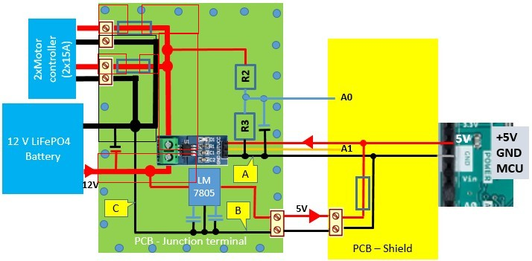

Slide 32
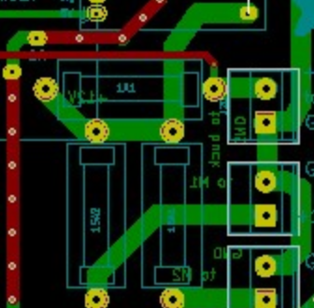
3mm trace on top & bottom copper + vias

Slide 33
From buck converter
* 3xUltras. Distance ** Motor Direction *** Push buttons
**** Encoder, PWM
To buck converter
For external reference
1 A
JST-XH 2.5mm
With 2,3,4,6 pins
78033V3
A
15 A
1k
4xSerial
3xI2C
1N4001
B
To 2 x motor controller power
****
15 A
*
R1
12V
LiFePO4
For battery volt meter
**
R2
100n
(ceramic)
***
Current measurement

Slide 34
2 x 12V DC motors
2 x rated 4.3A
2 x DC motor controller
1N4001
batVoltage = 10 - 14.6V
(4 cells of LiFePO4)
2xDIR1 2xDIR2
2xPWM
30 A (2 x 15 A)
2 A
switch mode "buck" regulator
Arduino MEGA
R1
+5V
(The divider is required to measure the battery voltage.)
Vin
A0
+5V
Sensor(s)
Sig
R2
GND
GND
Boundary of the Shield

Slide 35
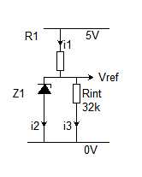
I_{supply}
batVoltage = 14.6 - 10 V
Arduino MEGA
51k
R2
Vin
+5V
VR1 = 5V - 4.1V = 0.9V
A0 volt max (shall be 0.3 V less than V REF (4.1V) => 3.8 V
13.5V*20k/(20k+51k) = 3.802V
1k
A0
R1
Select first this diode to measure near to the desired voltage:
A0volt
AREF
R3
LM4040 AIZ -4.1 (4.096 V +/- 0.1%)
20k
100n
(ceramic)
GND
Operating: from 60 μA to 15 mA
I₁= 0.9V / 1k = 900 µA
I₃= 4.1V / 32k = 128 µA
I₂= 900 µA - 128 µA = 772 µA
VR1 = 5V – 2.5V = 2.5V
= 4.1V
I₁= 2.5V / 1k = 2500 µA
I₃= 2.5V / 32k = 78 µA
I₂= 2500 µA - 78 µA = 2422 µA

Slide 36
batVoltage = 14.6 - 10.0 V
Arduino MEGA
DS18B20
Temperature sensor
51k
R2
Vin
+5V
D2
A0
R1
1k
R3
AREF
20k
LM4040 AIZ -4.1 (4.096 V +/- 0.1%)
100n
(ceramic)
GND

Slide 37
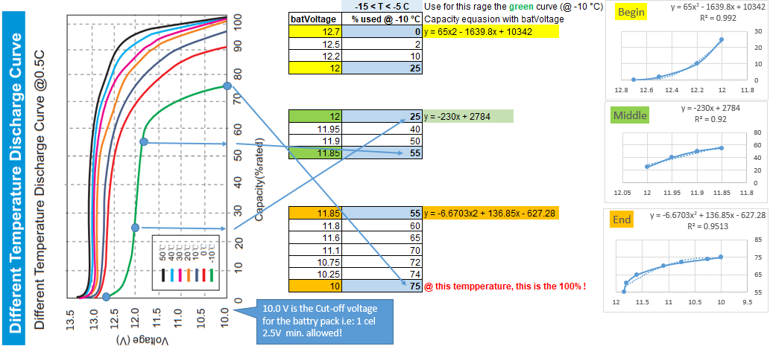
Here is my approach:
The battery discharge curve depending on a lot of parameters (temperature, chemistry, charge & discharge rates etc.)
The most significant from my point of view is the temperature, which can be relatively easily and accurately involved in capacity calculation as well.
So first of all everybody, who will follow the next steps, have to have the discharge curve for his own battery and correct the figures accordingly to avoid any error.
Take the curve and specific temperature, split in three or more sections. Take and values manually and fetch in tables.
Do the regression (insert trend line) with a software (Excel etc.) and make the equation for the curve visible on the graph.
Hardcode the rages and equation in the script. Measure the temperature and pass in the function.

Slide 38
I_{supply}
batVoltage = 14.6 - 10 V
Arduino MEGA
ACS712 Current sensor
51k
R2
Vin
A1
+5V
A0 volt max=
13.5V*20k/(20k+51k) = 2.368 V
A0
DS18B20
Temperature sensor
A0volt
D2
R1
INTERNAL2V56
T_{battery}
20k
GND
100n
(ceramic)

Slide 39
V_{out} (V)
on INA 21X
5V
V_{out} (V)
on INA 21X
Load current (A)
10
5V
Load current (A)
10

Slide 40
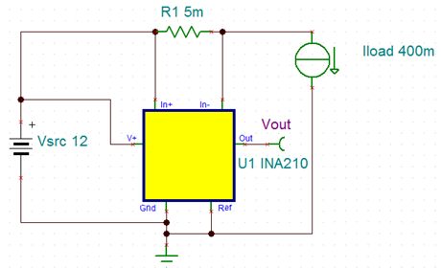
batVoltage = 14.6 - 10.0 V
Rshunt
batMaxCap = 12Ah
Load
I _{load} = 0-10 A (max)
IN+
INA 213
(Gain 50V/V)
IN-
V+
Out
To ADC
on MEGA
Vout
100n
(ceramic)
bypass
GND
Ref
V_{out} = (I_{load} * R_{shunt} )*Gain + V_{ref}
R_{shunt} = V_{out} /(I_{load} *Gain)=
= 5V/(10A*50) = 0.01 Ω (10m Ω)

Slide 41
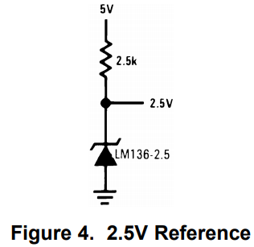
https://www.hindawi.com/journals/isrn/2013/953792/
https://www.sciencedirect.com/science/article/pii/S0307904X13000462
12V DC motor
DC motor controller
DIR1 DIR2
PWM
4.7kΩ
Battery terminal Voltage = 14.6 - 10.0 V
pullup
10mΩ
Rshunt
1k
T_{battery}
R1
MEGA
51k
Vin
R2
IN+
+5V
DS18B20
Temperature sensor
INA 213
(Gain 50V/V)
IN-
A0
D2
V+
Out
A1
100n
(ceramic)
bypass
Vout
AREF
GND
Ref
R3
20k
100n
(ceramic)
GND
LM4040 AIZ-4.1
LM136-2.5
LM236-2.5
LM336-2.5
LM385Z-2.5G

Slide 42
switch mode "buck" regulator
batVoltage = 10 - 14.6V
(4 cells of LiFePO4)
R1
Arduino MEGA
+5V
(The divider is required to measure the battery voltage.)
Vin
A0
+5V
Sensor(s)
R2
Sig
GND
GND
Boundary of the Shield

Slide 43
33Ω
batVoltage = 10 - 14.6V
(4 cells of LiFePO4)
switch mode "buck" regulator
R3
R1
Arduino MEGA
+5V
(The divider is required to measure the battery voltage.)
Vin
A0
+5V
Sensor(s)
Sig
Z1
5.V / 1W
R2
GND
GND
Boundary of the Shield

Slide 44
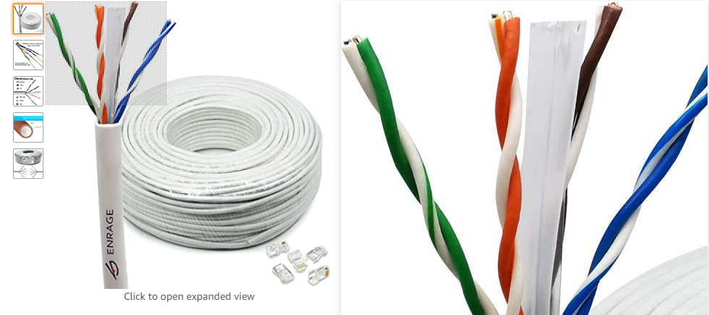
Ethernet CAT 5 then put each signal SDL and SDA in separate pairs with the wire that is not carrying the signal grounded. Example: Red = SDA, Blue = SCL, The whites from each becomes Ground, the Brown and Green become 5V with there whites also grounded. This should work. P.S. You need to only ground one end of the shield wires on SCA and SCL.

Slide 45
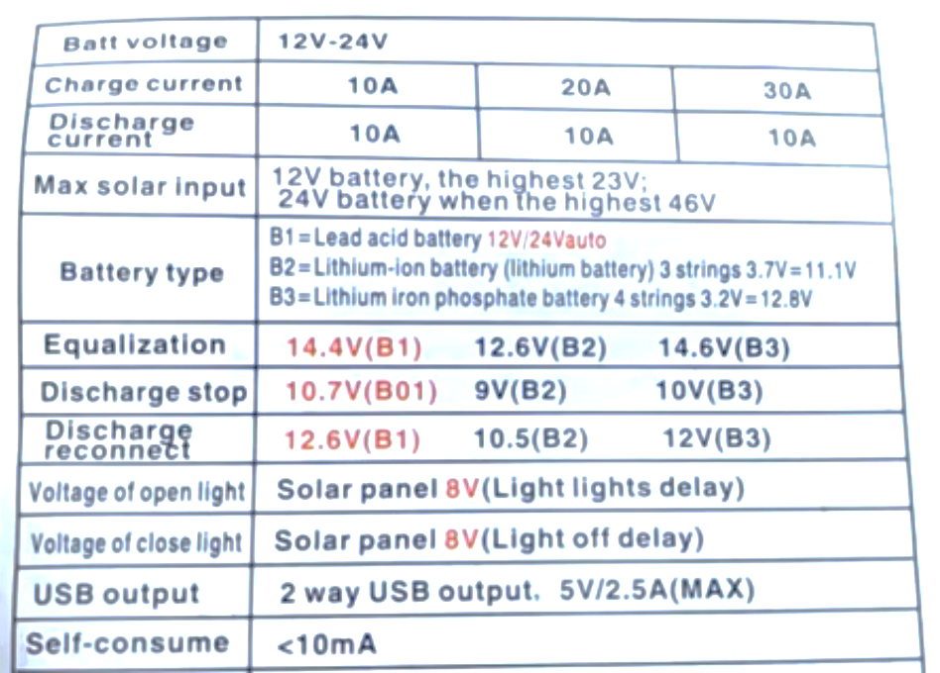
LiFePO4 - Solar charger

Slide 46
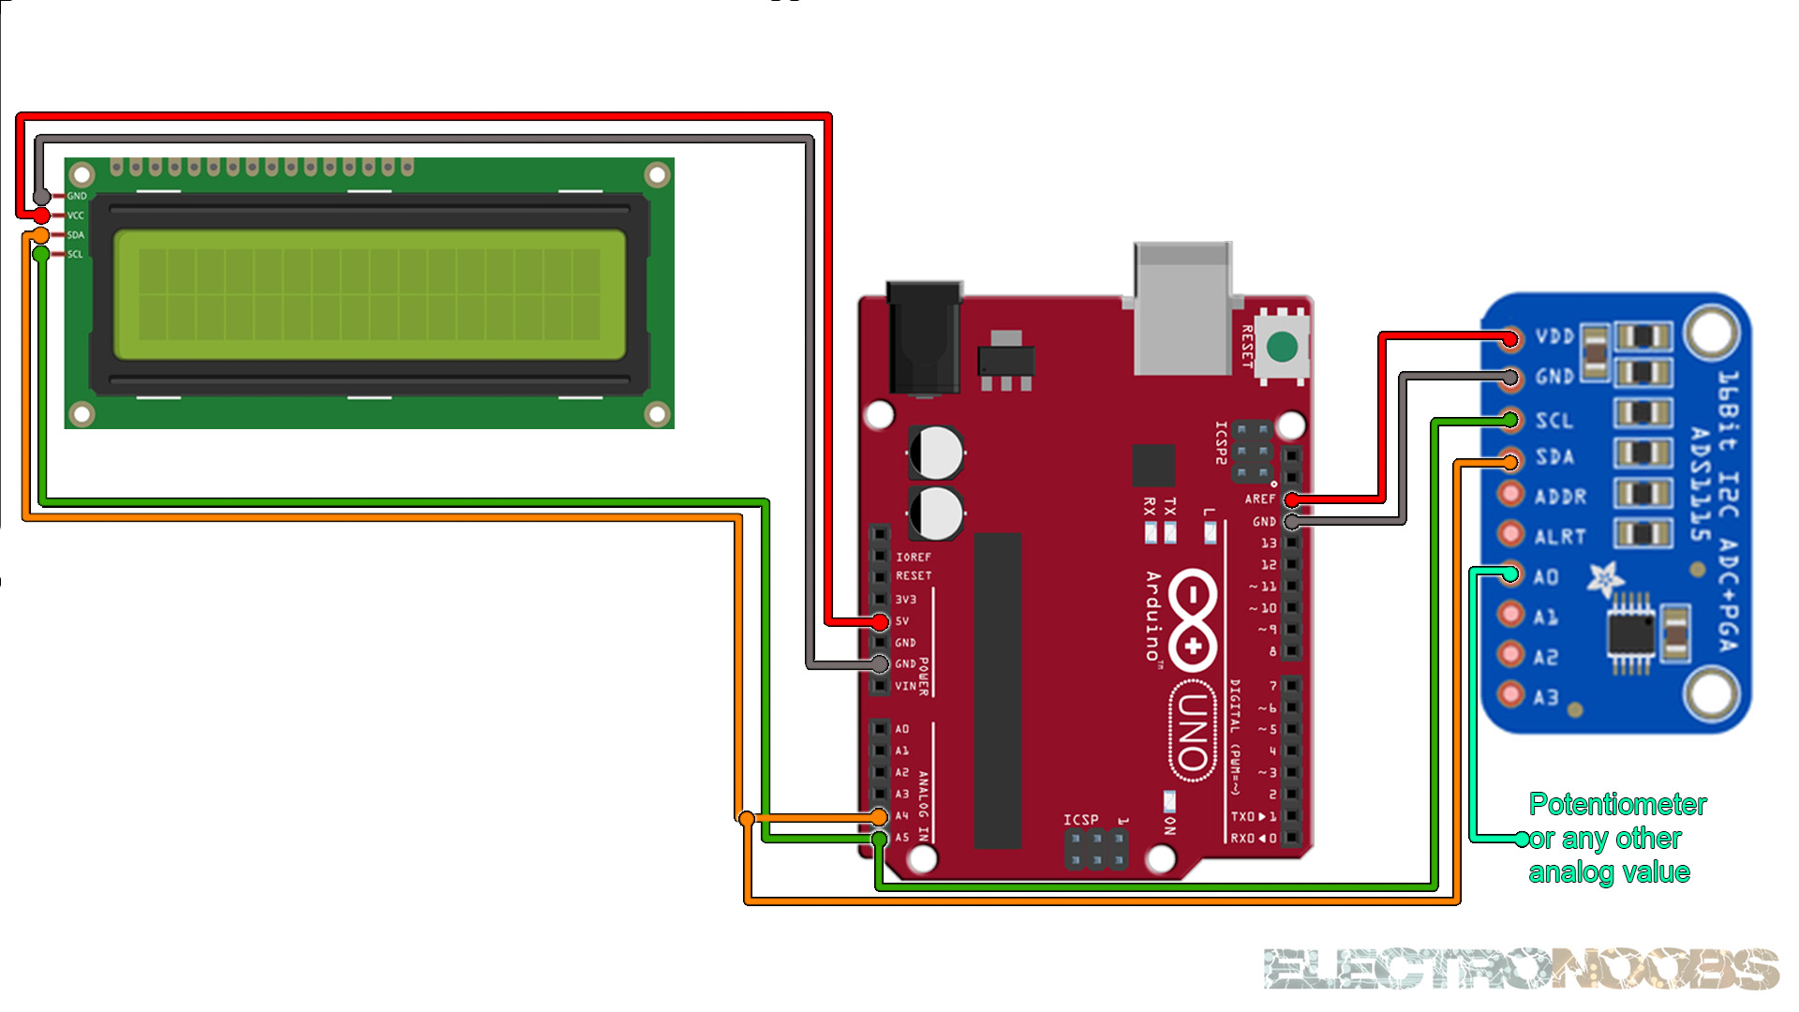
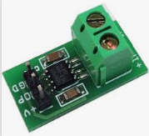
#include <Wire.h>
#include <Adafruit_ADS1015.h>
Adafruit_ADS1115 ads;
const float multiplier = 0.1875F;
void setup(void)
{
Serial.begin(9600);
// Descomentar el que interese
// ads.setGain(GAIN_TWOTHIRDS); +/- 6.144V 1 bit = 0.1875mV (default)
// ads.setGain(GAIN_ONE); +/- 4.096V 1 bit = 0.125mV
// ads.setGain(GAIN_TWO); +/- 2.048V 1 bit = 0.0625mV
// ads.setGain(GAIN_FOUR); +/- 1.024V 1 bit = 0.03125mV
// ads.setGain(GAIN_EIGHT); +/- 0.512V 1 bit = 0.015625mV
// ads.setGain(GAIN_SIXTEEN); +/- 0.256V 1 bit = 0.0078125mV
ads.begin();
}
void loop(void)
{
int16_t adc0, adc1, adc2, adc3;
adc0 = ads.readADC_SingleEnded(0);
adc1 = ads.readADC_SingleEnded(1);
adc2 = ads.readADC_SingleEnded(2);
adc3 = ads.readADC_SingleEnded(3);
Serial.print("AIN0: "); Serial.println(adc0 * multiplier);
Serial.print("AIN1: "); Serial.println(adc1 * multiplier);
Serial.print("AIN2: "); Serial.println(adc2 * multiplier);
Serial.print("AIN3: "); Serial.println(adc3 * multiplier);
Serial.println(" ");
delay(1000);
}
http://www.electronoobs.com/eng_arduino_tut83.php
ASC712

Slide 47
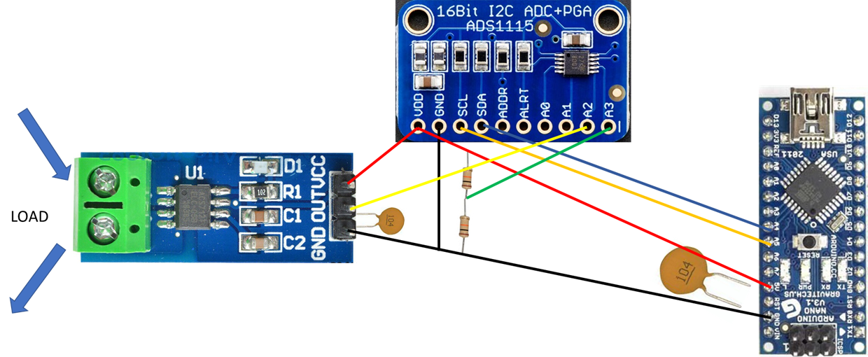

Slide 48
ASC714
100n
(ceramic)
batVoltage = 10 - 14.6V
(4 cells of LiFePO4)
5V from
buck converter
5V
Arduino MEGA
ADS1115
VDD
10k
Vout [Zero] = Vcc/2
(2.5V)
A3
100n
(ceramic)
A2
A1
SDA
SCL
SDA
SCL
10k
A0
GND
GND

Slide 49
ASC714
100n
(ceramic)
batVoltage = 10 - 14.6V
(4 cells of LiFePO4)
5V from
buck converter
5V
10k
Arduino MEGA
ADS1115
VDD
Vout [Zero] = Vcc/2
(5 - 7.3 V)
A3
A2
10k
A1
SDA
SCL
SDA
SCL
A0
GND
GND
100n
(ceramic)

Slide 50


Max. 5.8 V

Slide 51


https://www.youtube.com/watch?v=FpkUXmM7mrc
ZED-F9P Base and Rover Configuration
3dr radio telemetry
77.287437
28.458505
28.458474151945538
77.28736728429794
https://www.maps.ie/coordinates.html
7 digit accuracy: 0.0000001 0.015 m 1.5 cm

Slide 52

BASE
ROVER
Antenna
Tallysman TW7972
Antenna
Tallysman TW7972
Antenna
Tallysman TW7972
How the navigation module can communicate to the MCU ?
A: via a RS232 GPRMC NMEA
Like this: $GPRMC,001225,A,2832.1834,N,08101.0536,W,12,25,251211,1.2,E,A*03
Radio
not included in xNAV650
GNSS+IMU
Multi band
RTK
Base station
Can’t be xNAV650
MCU
HITEX ShieldBuddy TC375 or on Arduino MEGA
How communicating ?
A: Using serial input on the xNAV and an independent radio receiver.
Radio
not included in xNAV650
RTK
Motor control
With encoders

Slide 53
Decoding results
Position | 28.536390°N 81.017560°W
Timestamp | Sun, 25 Dec 2011 00:12:25 UTC
Movement | Speed 12.0 kts, heading 25°
Close to | Christmas, United States
Local time | Sat, 24 Dec 2011 19:12:25 EST
Timezone | America/New_York (UTC -0500)
https://rl.se/gprmc
Dear Customer Support,
I'm looking for moving base and robot rover setup for agricultural application in remote places.
My rover is using Arduino MEGA.
Base side MCU: still to be developed.
For Base – single rover configuration I'm searching for:
Base:
multi band GNSS receiver
+ XBee (up to 10km LoS) send the RTK correction data to the rover
+ 1 antenna
(The fix location of the base to be set after (10 min - 60 min) survey.)
Rover:
multi band GNSS receiver
+XBee (up to 10km LoS) to receive the RTK data from base
+ 1 or 2 antennas
+ IMU (for heading)
Please advise for system configuration.
I would highly appreciate, if You send a block diagram about the information flow as well :-).
In case of any questions, get it touch.
Thank You very much for Your help and support in advance.
Have a nice day ahead.
With Regards,
Andras
https://www.ardusimple.com/contact/

Slide 54


Slide 55


Slide 56

As per last r-mail:
That’s no problem if you don’t need the full NCOM data, you can also have NMEA data output over serial or ethernet. For example you can output GPRMC NMEA messages which contain
1 Time Stamp
2 validity - A-ok, V-invalid
3 current Latitude
4 North/South
5 current Longitude
6 East/West
7 Speed in knots
8 True course – Is this the true heading id degree with 0.1° accuracy ??
9 Date Stamp
10 Variation
11 East/West
12 checksum

Slide 57







simpleRTK2B is u-blox ZED-F9P
ZED-F9K & ZED-F9R has an IMU, but F9P no, because it can be base as well !
Select for
rover
Select for base

Slide 58
BASE
ROVER
Calibrated Survey GNSS Multiband antenna
Calibrated Survey GNSS Multiband antenna
(RTCM corr. data)
(RTCM corr. data)
RTK
TX⇨RX2
RTK+INS simpleRTK2B-F9R V3 shield in stand alone mode
Radio
XBee LR
simpleRTK2Blite
(ZED-F9P )
Laptop
RX⇦TX1
Rover pos.
https://www.ardusimple.com/product/simplertk2b-f9r-v3/
RX⇦TX2
(rover pos.)
(rover pos.)
TX1⇨RX0-3 (MEGA)
https://www.ardusimple.com/product/simplertk2blite/
Arduino MEGA
TX2⇨RX
TX⇨RX2
(rover pos.)
(RTCM corr. data)
RTK
(RTCM corr. data)
Radio
XBee LR
Rover pos.
Motor control
With encoders
https://www.ardusimple.com/product/simplertk2b-heading-basic-starter-kit-ip67/

Slide 59
simpleRTK2Blite 199,00€
RTK+INS simpleRTK2B-F9R V3 486,00€
headers 5,00€
Pixhawk cable set 15,00€
XBee (LR) + Antenna 116,00€
XBee (LR) + Antenna 116,00€
Calibrated Survey GNSS Multiband antenna (IP67) 149,00€
Calibrated Survey GNSS Multiband antenna (IP67) 149,00€
Stand for survey GNSS Multiband antenna 18,00€
Stand for survey GNSS Multiband antenna 18,00€

Slide 60


Slide 61

U-blox 6
Receiver description
Including protocol description
const unsigned char UBX_HEADER[] = { 0xB5, 0x62 };
struct NAV_POSLLH {
unsigned char cls;
unsigned char id;
unsigned short len;
unsigned long iTOW;
long lon;
long lat;
long height;
long hMSL;
unsigned long hAcc;
unsigned long vAcc;
};

Slide 62
const unsigned char UBX_HEADER[] = { 0xB5, 0x62 };
struct NAV_PVT {
unsigned char cls;
unsigned char id;
unsigned short len;
unsigned long iTOW; // GPS time of week of the navigation epoch (ms)
unsigned short year; // Year (UTC)
unsigned char month; // Month, range 1..12 (UTC)
unsigned char day; // Day of month, range 1..31 (UTC)
unsigned char hour; // Hour of day, range 0..23 (UTC)
unsigned char minute; // Minute of hour, range 0..59 (UTC)
unsigned char second; // Seconds of minute, range 0..60 (UTC)
char valid; // Validity Flags (see graphic below)
unsigned long tAcc; // Time accuracy estimate (UTC) (ns)
long nano; // Fraction of second, range -1e9 .. 1e9 (UTC) (ns)
unsigned char fixType; // GNSSfix Type, range 0..5
char flags; // Fix Status Flags
unsigned char reserved1; // reserved
unsigned char numSV; // Number of satellites
used in Nav Solution
long lon; // Longitude (deg)
long lat; // Latitude (deg)
long height; // Height above Ellipsoid (mm)
long hMSL; // Height above mean sea level (mm)
unsigned long hAcc; // Horizontal Accuracy Estimate (mm)
unsigned long vAcc; // Vertical Accuracy Estimate (mm)
long velN; // NED north velocity (mm/s)
long velE; // NED east velocity (mm/s)
long velD; // NED down velocity (mm/s)
long gSpeed; // Ground Speed (2-D) (mm/s) long heading; // Heading of motion 2-D (deg) unsigned long sAcc; // Speed Accuracy Estimate unsigned long headingAcc; // Heading Accuracy Estimate unsigned short pDOP; // Position dilution of precision short reserved2; // Reserved unsigned long reserved3; // Reserved};
void loop() { if ( processGPS() ) { Serial.print("#SV: "); Serial.print(pvt.numSV); Serial.print(" fixType: "); Serial.print(pvt.fixType); Serial.print(" Date:"); Serial.print(pvt.year); Serial.print("/"); Serial.print(pvt.month); Serial.print("/"); Serial.print(pvt.day); Serial.print(" "); Serial.print(pvt.hour); Serial.print(":"); Serial.print(pvt.minute); Serial.print(":"); Serial.print(pvt.second); Serial.print(" lat/lon: "); Serial.print(pvt.lat/10000000.0f); Serial.print(","); Serial.print(pvt.lon/10000000.0f); Serial.print(" gSpeed: "); Serial.print(pvt.gSpeed/1000.0f); Serial.print(" heading: "); Serial.print(pvt.heading/100000.0f); Serial.print(" hAcc: "); Serial.print(pvt.hAcc/1000.0f); Serial.println(); }}

Slide 63





Slide 64


